Slide 1
Essential Systems
The Race to a New System
Louis Ries, Andrew Huff, Krysta Albertson, Nick Phelps, Jordan Gates, Adam Passanisi
Kentucky Horsemen’s Benevolent and Protective Association

Slide 2
Agenda
Problem
Data Dictionary (Tables)
Prototypes
Review
ERD

Slide 3
Problem Statement
Can’t receive money for reports or donations online
No ability to process forms, claims, memberships, sales bills or reports online
Newsletter not electronically available online
No plan for business continuity
Mobile website needs to be modernized

Slide 4
ERD
ERD- Entity Relationship diagram
These are the different databases that will store information from the website.
Also, shows the relationships from the different data bases
Everything starts with USER
Then branches off to become an employee or a member
Using a relation database model such as this cuts down on the need to insert the same information in different places

Slide 5
Data Dictionary
Table Name | Attribute | Data Type | Size | Nullable
Employee | Employee ID | Int | 10 | No
 | Employee_Fname | String | 50 | No
 | Employee_Lname | String | 50 | No
 | Employee_Job | String | 25 | No
 | Employee_Password | VarChar | 255 | No
 | User ID | Int | 10 | No
User | UserID | Int | 10 | No
 | User_Fname | String | 50 | No
 | User_Lname | String | 50 | No
 | User_email | VarChar | 255 | No
Member | MemberID | Int | 10 | No
 | Member_Password | Varchar | 255 | No
 | Stable_Name | String | 50 | No
 | Street_Address | String | 50 | No
 | Phone_Number | String | 50 | No
 | KRC_License_Num | Int | 10 | No
 | UserID | Int | 10 | No

Slide 6
Prototypes
Create Member
Log into Account
Make a Donation
Send Newsletter
Submit Forms
Process Claim
Recover Data
Backup Data

Slide 7
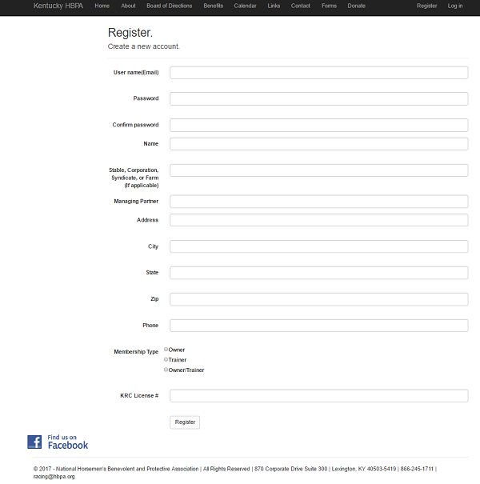
Create Member

Slide 8
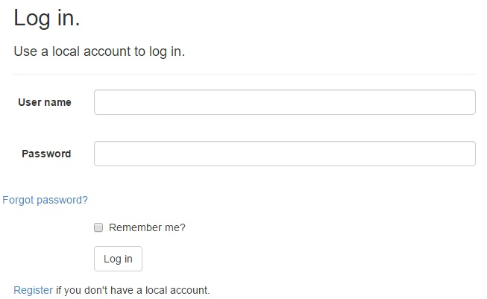
Log into Account

Slide 9
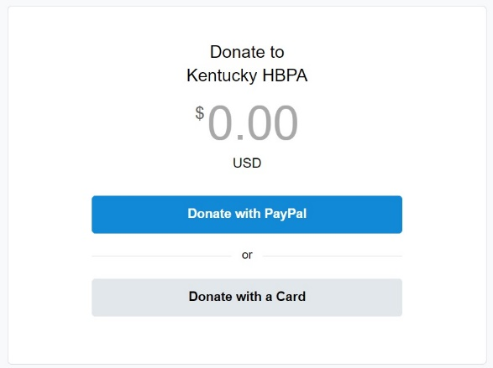
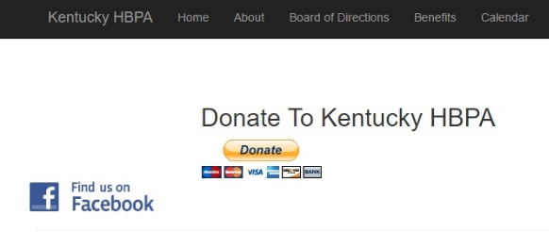
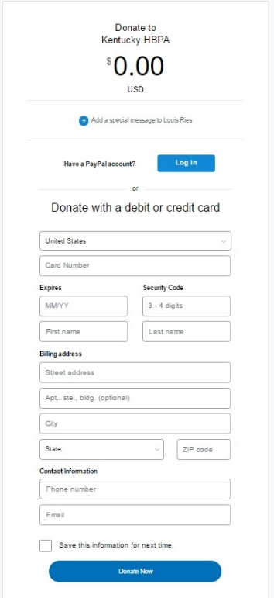
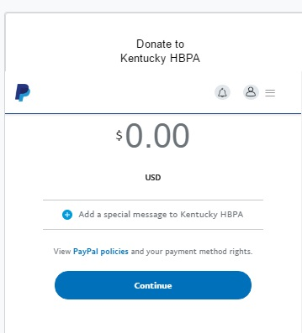
Make a Donation

Slide 10
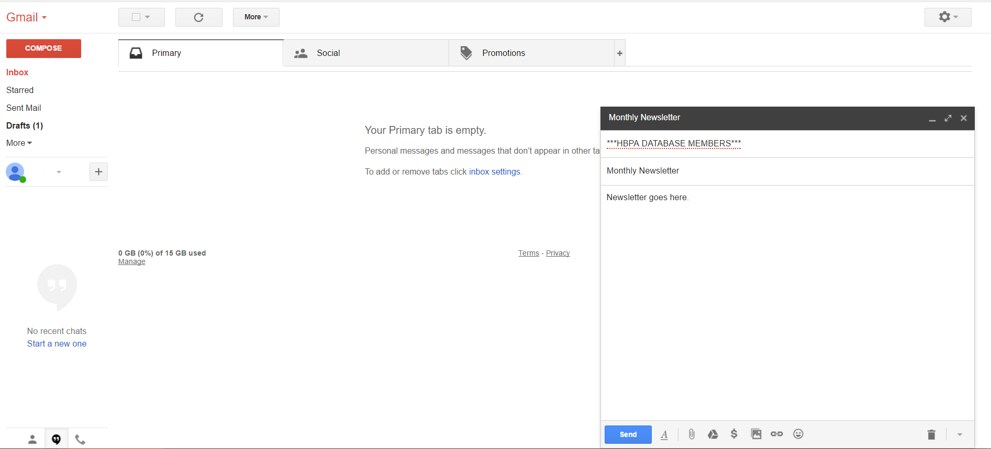
Send Newsletter

Slide 11
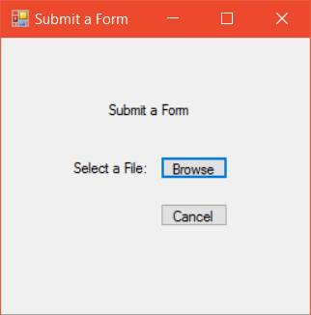
Submit Forms

Slide 12
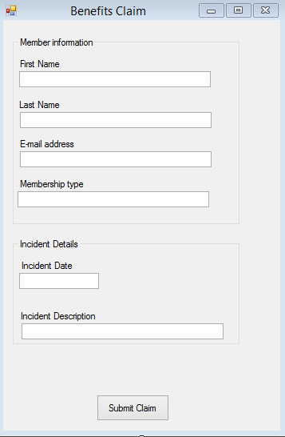
Process Claims

Slide 13
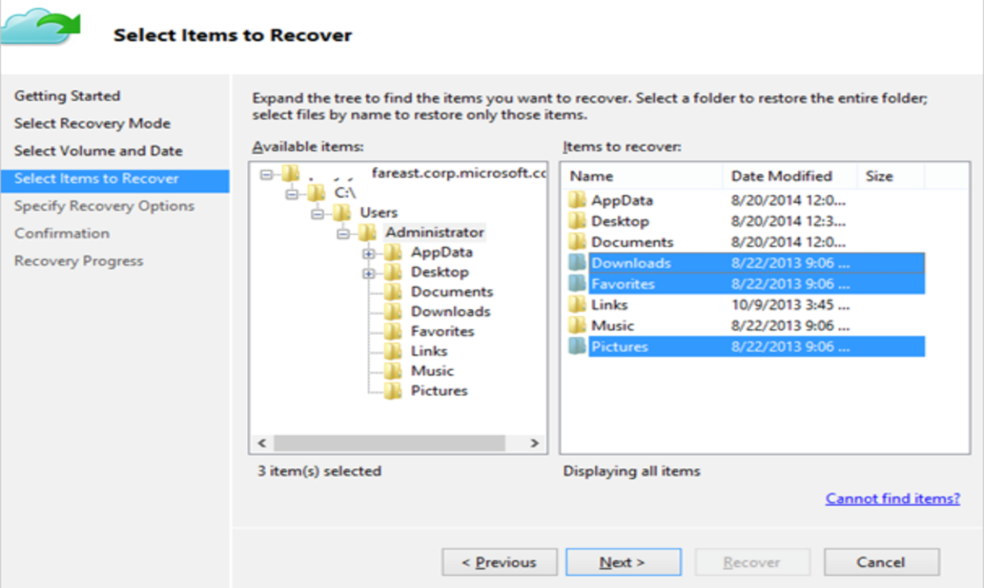

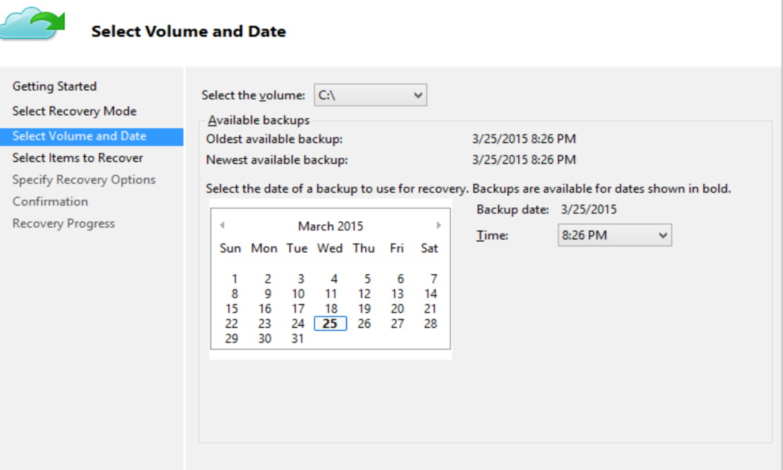
Backup Data

Slide 14
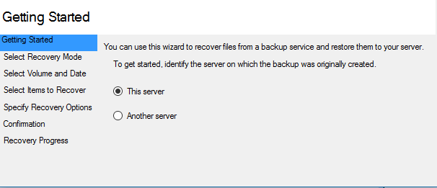
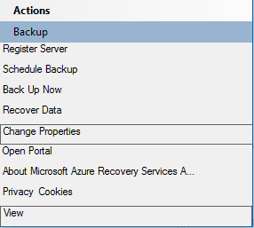
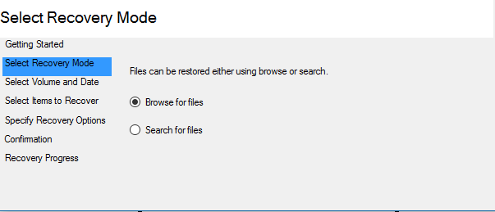
Recover Data

Slide 15
Review
Problem
Data Dictionary (Tables)
Prototypes
Review
ERD

Slide 16
Questions?

